Slide 1
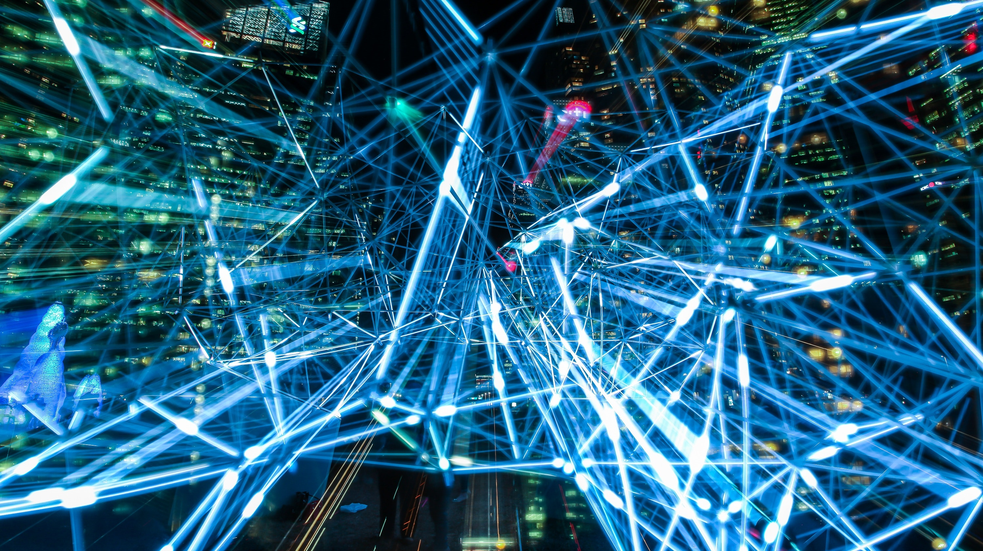
Intro to Deep Learning

Slide 2
What is deep learning?
Deep learning theory started in the 80s, but didn’t gain traction until the late 2000s due to computational limitations.
Inspired by neurology
Main idea: chain together very many “neurons” (simple) to create a large, complex model of (potentially) millions of neurons (complex).
First layer accepts data straight from input – next layers accept input from previous layers.
This depth allows models to learn complex nonlinear patterns.

Slide 3
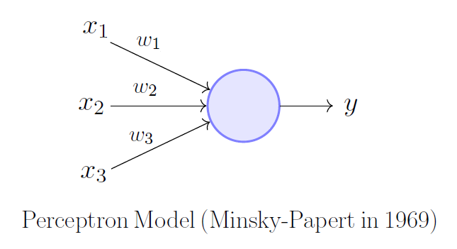
The Neuron

Slide 4
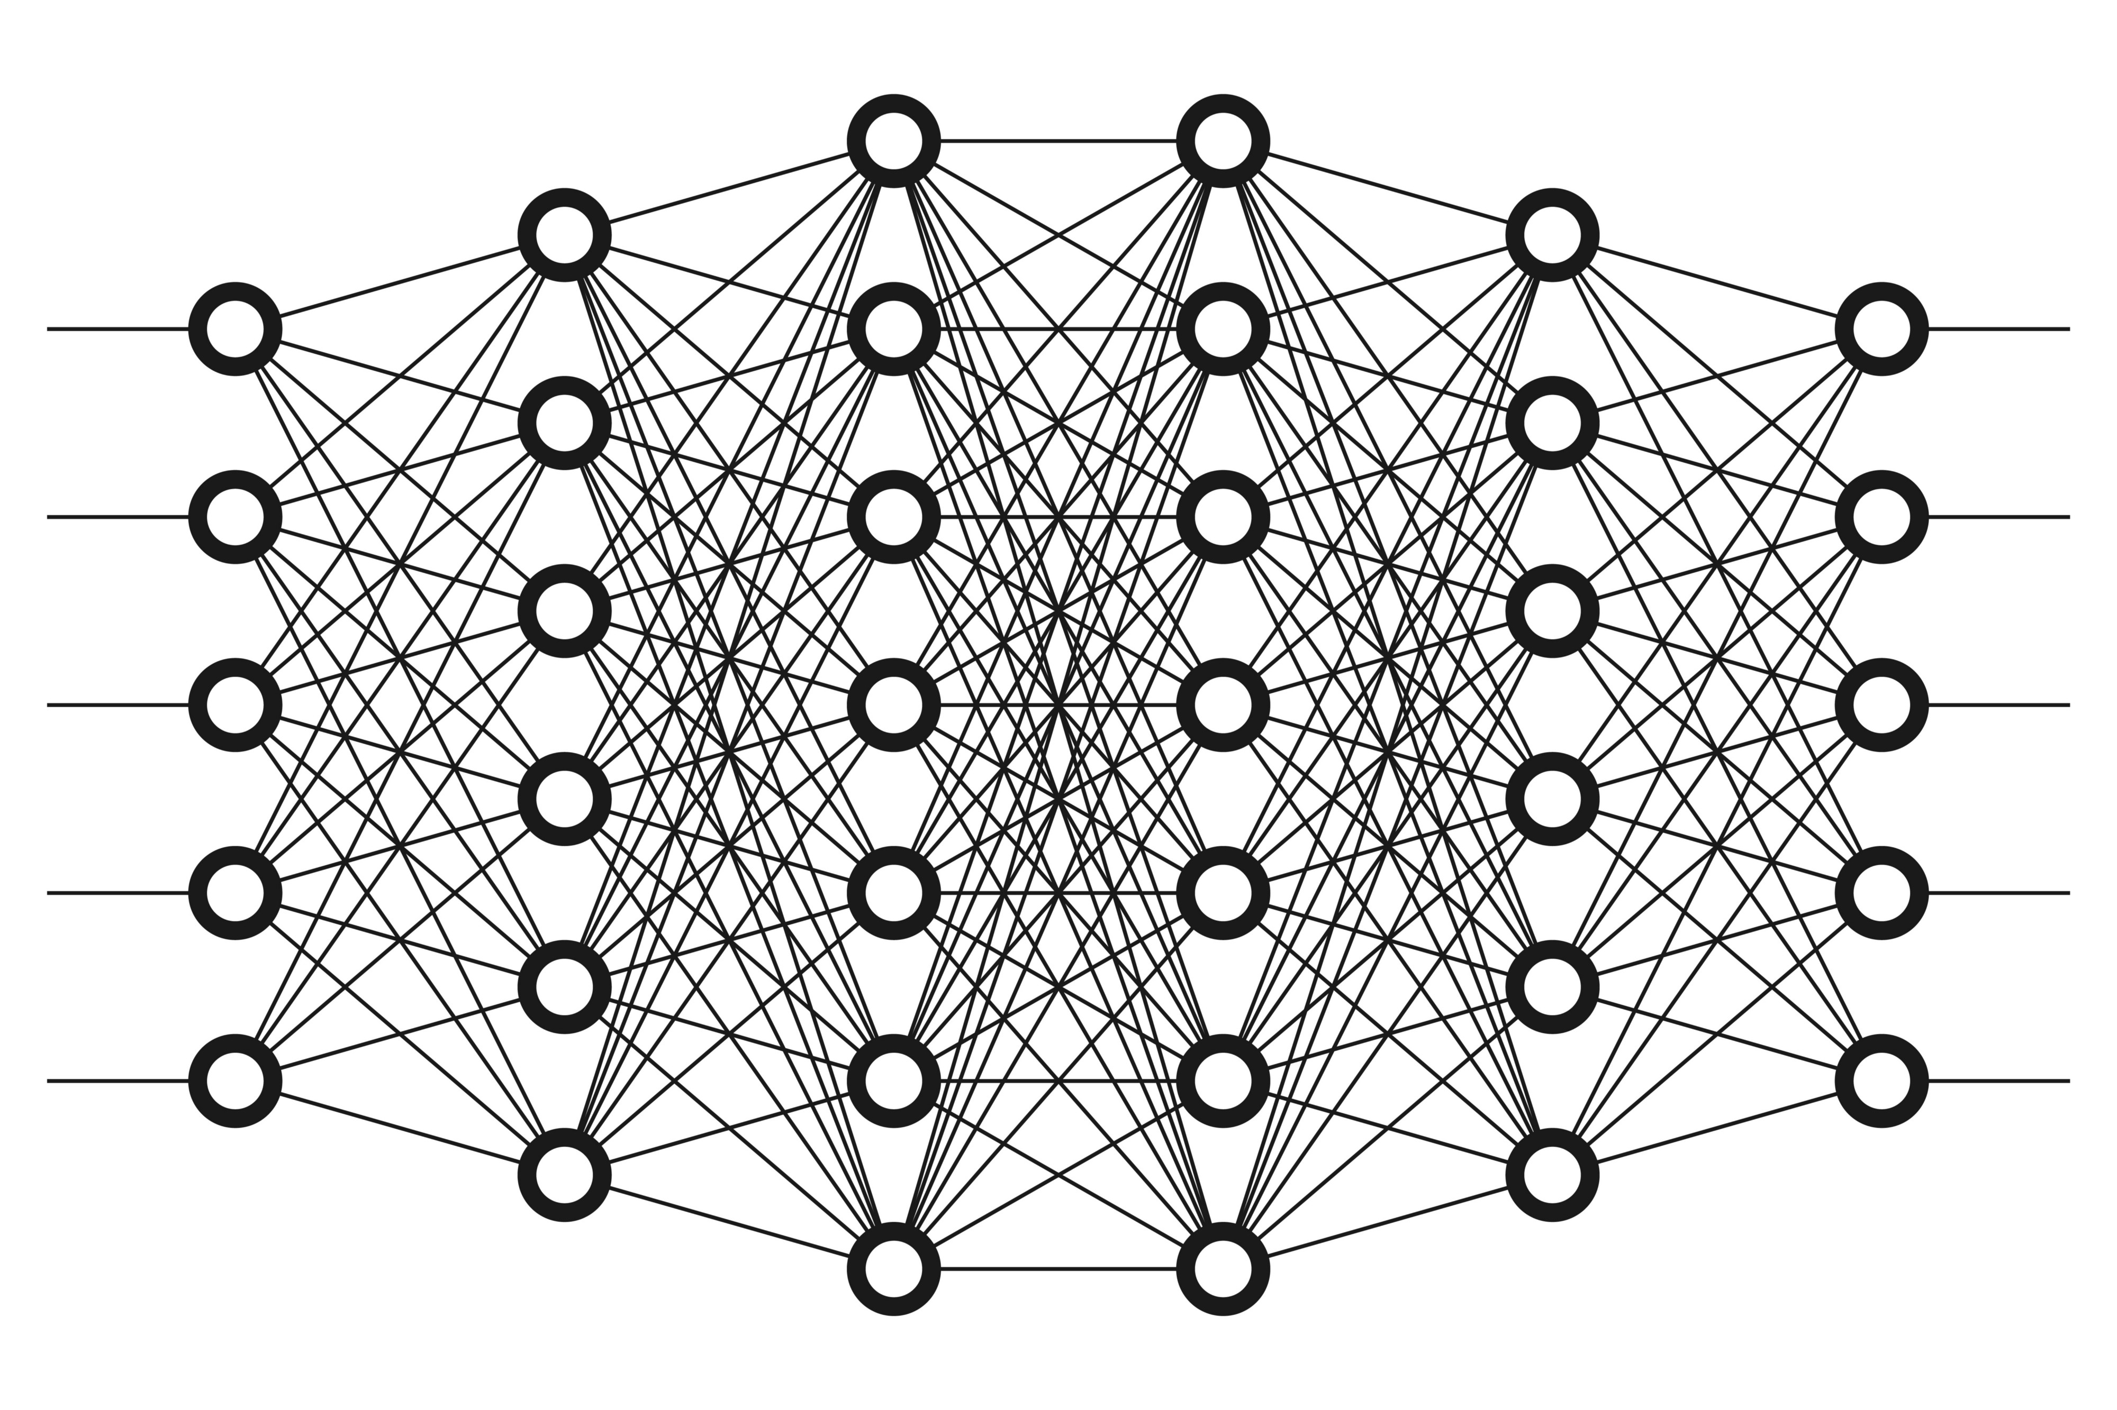
The Network

Slide 5
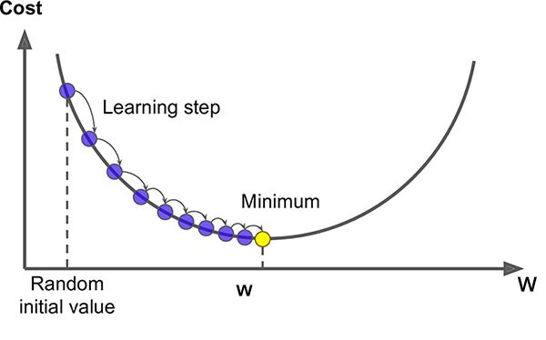
How are weights updated?
Loss function
Optimiser
Backpropagation

Slide 6
Different Types of “Layers”
“Fully Connected”
Recurrent (RNN, LSTM, GRU)
Convolutional
Many more, constantly being invented and tested

Slide 7
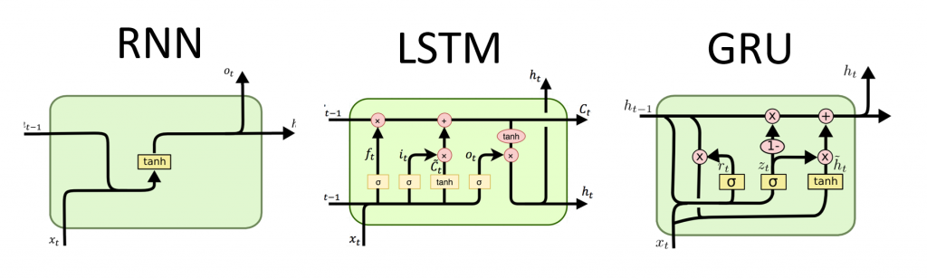
Recurrent layers

Slide 8
Convolutional layers

Slide 9
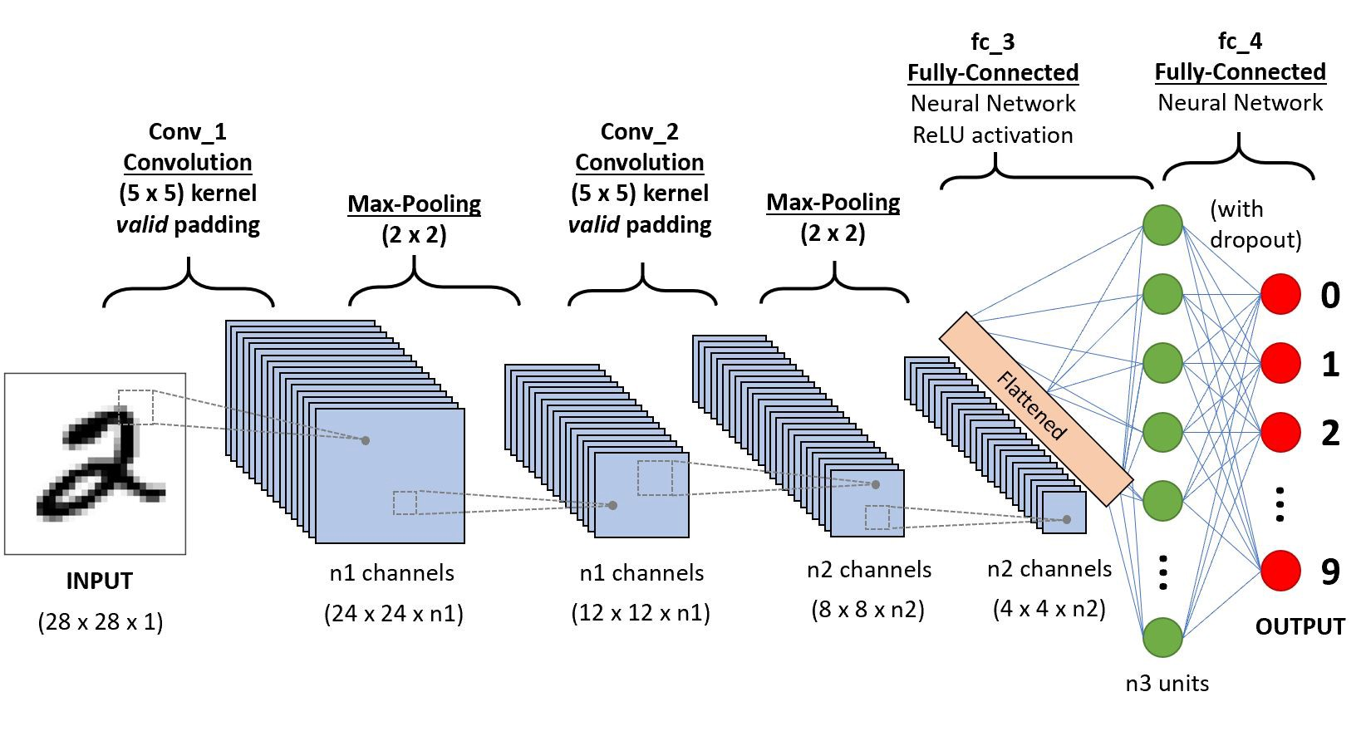
Convolutional layers

Slide 10
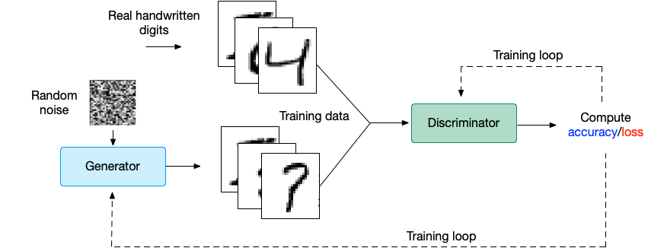
Not just for regression or classification

